Slide 1




NEXT GEN EMPLOYABILITY PROGRAM
Creating a future-ready workforce
Team Members
College Name Paavai college of engineering ,nammakal
Student Name :VENKAT VIJAY MP
Student ID : au622021104119

Slide 2

CAPSTONE PROJECT SHOWCASE
Project Title
Building Bus Reservation System using Python and Django
Abstract | Problem Statement | Project Overview | Proposed Solution | Technology Used | Modelling & Results | Conclusion

Slide 3
Abstract
In the contemporary world of transportation, efficient management systems are pivotal to streamline the booking process and ensure a seamless experience for passengers. This abstract outlines the development of a Bus Reservation System (BRS) utilizing Python and Django framework. The system aims to provide a user-friendly interface for passengers to reserve bus tickets, while also facilitating efficient management tools for bus operators
The Bus Reservation System is designed to encompass key features such as user authentication, seat availability checking, ticket booking, cancellation, and administration functionalities. Leveraging the Django framework allows for rapid development, scalability, and robust security measures.
Furthermore, the system implements responsive design principles to ensure accessibility across multiple devices, catering to a diverse user base. Additionally, considerations for data integrity, security, and scalability are incorporated into the development process.
Overall, the Bus Reservation System developed using Python and Django presents a comprehensive solution to streamline the bus booking process, enhancing the efficiency and convenience for both passengers and operators in the transportation industry.
Source :

Slide 4
Problem Statement
In today's fast-paced world, efficient transportation systems are essential for smooth operations and convenience for commuters. However, existing bus reservation systems often lack user-friendly interfaces and robust functionalities, leading to inconvenience and inefficiency for both passengers and bus operators. To address these challenges, there is a need to develop a modern, scalable, and user-centric Bus Reservation System using Python and Django.
The primary objective of this project is to design and implement a comprehensive Bus Reservation System that simplifies the process of booking bus tickets, managing bus routes, and facilitating seamless communication between passengers and bus operators. The system should offer an intuitive web interface accessible through various devices, ensuring convenience and accessibility for users.
Source :

Slide 5
Project Overview
Introduction: The Bus Reservation System is a web application designed to simplify the process of booking bus tickets for passengers. This project utilizes Python as the programming language and Django as the web framework to develop a robust and user-friendly reservation system.
2. Objectives:
To create a seamless and efficient online platform for bus ticket reservations.
To provide users with a convenient interface for searching buses, selecting seats, and making payments.
To implement administrative functionalities for managing buses, routes, schedules, and user bookings.
To ensure data security and integrity throughout the reservation process.
To enhance the overall user experience with responsive design and intuitive navigation.
3. Technologies Used:
Python: Programming language for backend development.
Django: Web framework for building the application's architecture.
HTML/CSS/JavaScript: Frontend development for user interface and interactivity.
SQLite/PostgreSQL: Database management system for storing application data.
Django REST Framework: API development for handling communication between frontend and backend.
Payment Gateway Integration: Stripe, PayPal, or other suitable payment gateways for processing transactions.
Source :

Slide 6
Proposed Solution
.
Setup Django Project:
First, create a new Django project using the following command:
django-admin startproject bus_reservation_system
Create Django App:
Inside the project directory, create a new Django app for handling bus reservation functionalities:
cd bus_reservation_system
python manage.py startapp reservation
Define Models:
Define Django models for buses, reservations, and users in
reservation/models.py
Source :

Slide 7
Requirement Analysis: Understand the requirements and objectives of the bus booking reservation system. Identify key features such as booking, cancellation, seat selection, payment processing, etc.
System Design:
User Interface: Design an intuitive user interface for customers to search for buses, select seats, and make bookings. Also, design an admin interface for bus operators to manage schedules, buses, and bookings.
Database Design: Design a database schema to store information about buses, schedules, seats, bookings, and users.
Backend Development: Develop the backend logic to handle user authentication, bus scheduling, seat availability, booking management, and payment processing.
API Development: Create RESTful APIs for communication between the frontend and backend components.
Key Features:
Bus Search: Allow users to search for buses based on source, destination, date, and time.
Seat Selection: Enable users to select seats from an interactive seat map.
Booking Management: Implement features for booking creation, modification, and cancellation.
Payment Gateway Integration: Integrate a payment gateway to facilitate secure online payments.
User Authentication: Implement user authentication and authorization mechanisms to ensure security.
Notifications: Send email or SMS notifications to users regarding booking confirmation, reminders, and updates.
Source :

Slide 8
Technology Stack:
Frontend: HTML, CSS, JavaScript, React.js, Angular, Vue.js
Backend: Node.js, Express.js, Django, Flask, ASP.NET Core
Database: MySQL, PostgreSQL, MongoDB
Payment Gateway: Stripe, PayPal, Razorpay
Deployment: AWS, Azure, Google Cloud Platform
Testing and Quality Assurance: Perform thorough testing including unit tests, integration tests, and user acceptance tests to ensure the system functions correctly and meets user requirements.
Deployment and Maintenance: Deploy the application on a reliable server and ensure regular maintenance to address bugs, security vulnerabilities, and to introduce new features as per user feedback.
User Feedback and Iteration: Gather feedback from users and continuously iterate on the application to improve user experience and add new features.
Source :

Slide 9

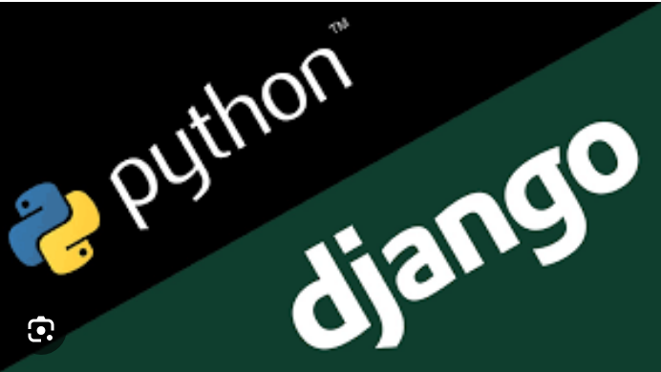
Technology Used
Front-end
Back-end
Source :

Slide 10
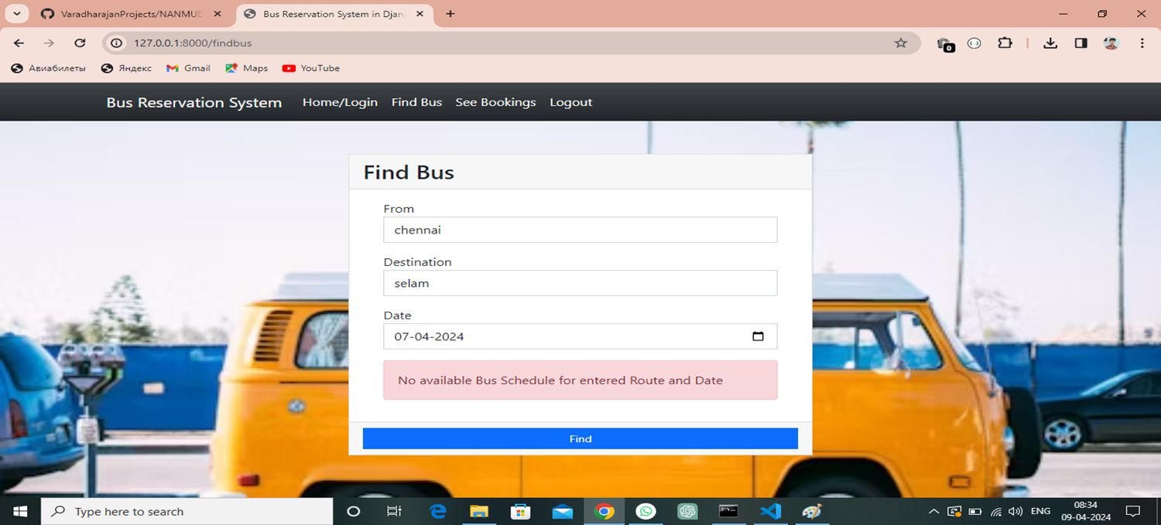
Modelling & Results
Source :

Slide 11
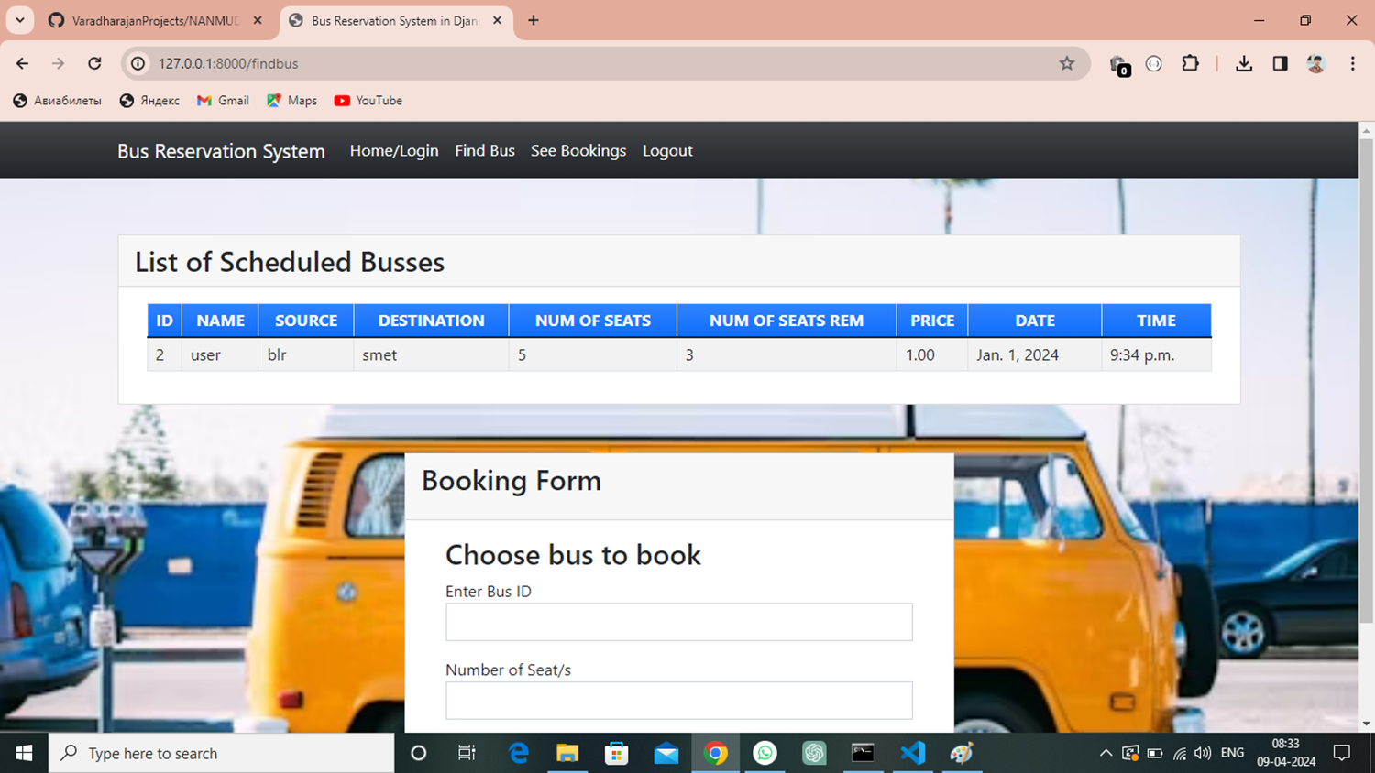
Homepage

Slide 12
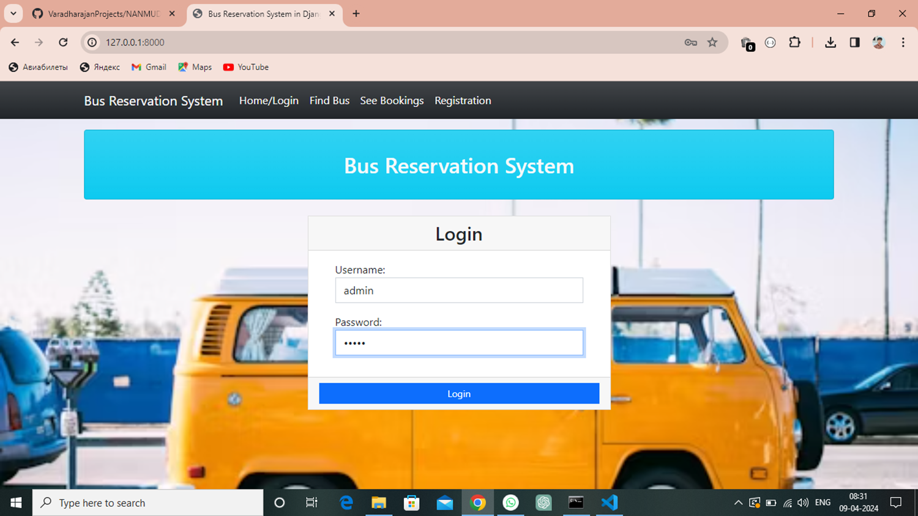
About-Us-Page

Slide 13
Service-Page

Slide 14
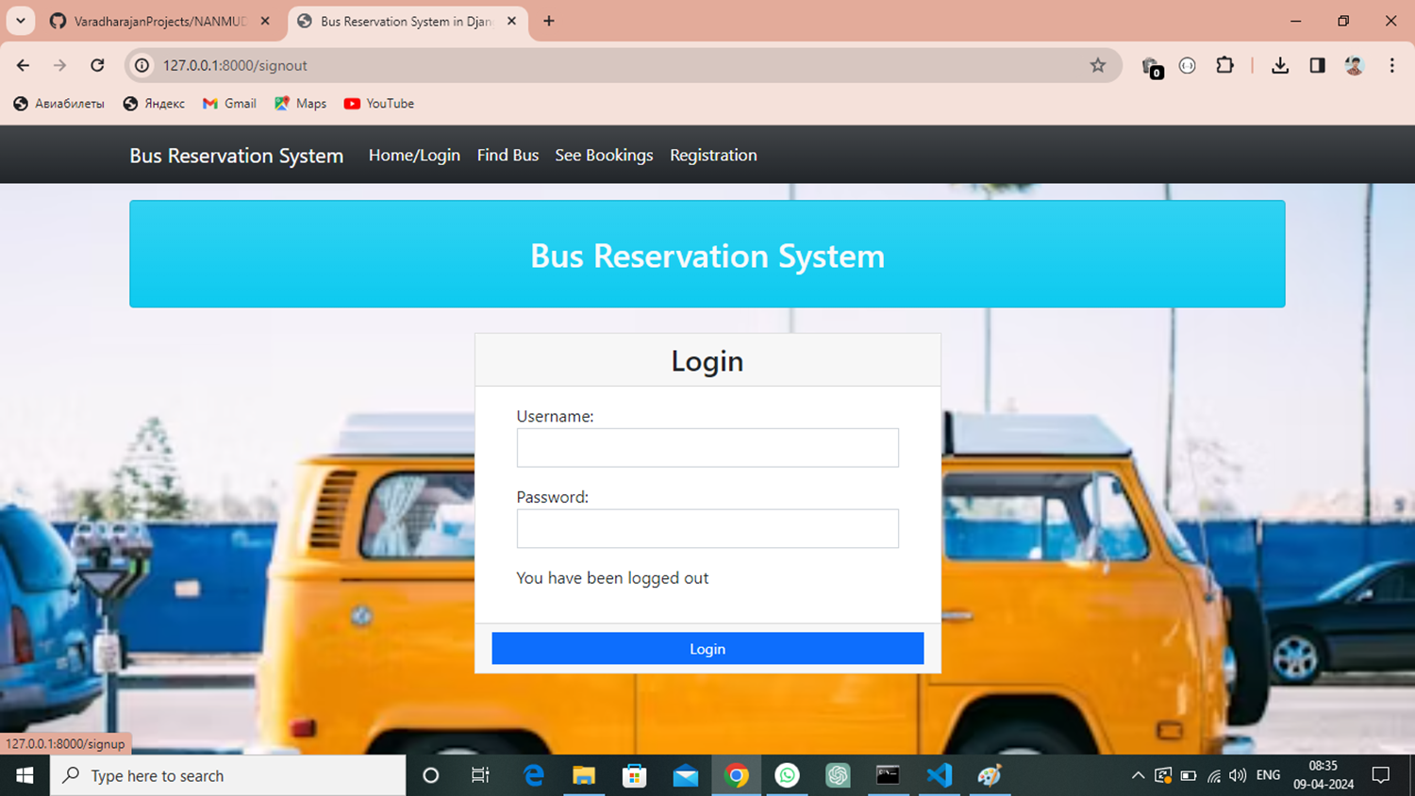
Departments-Page

Slide 15
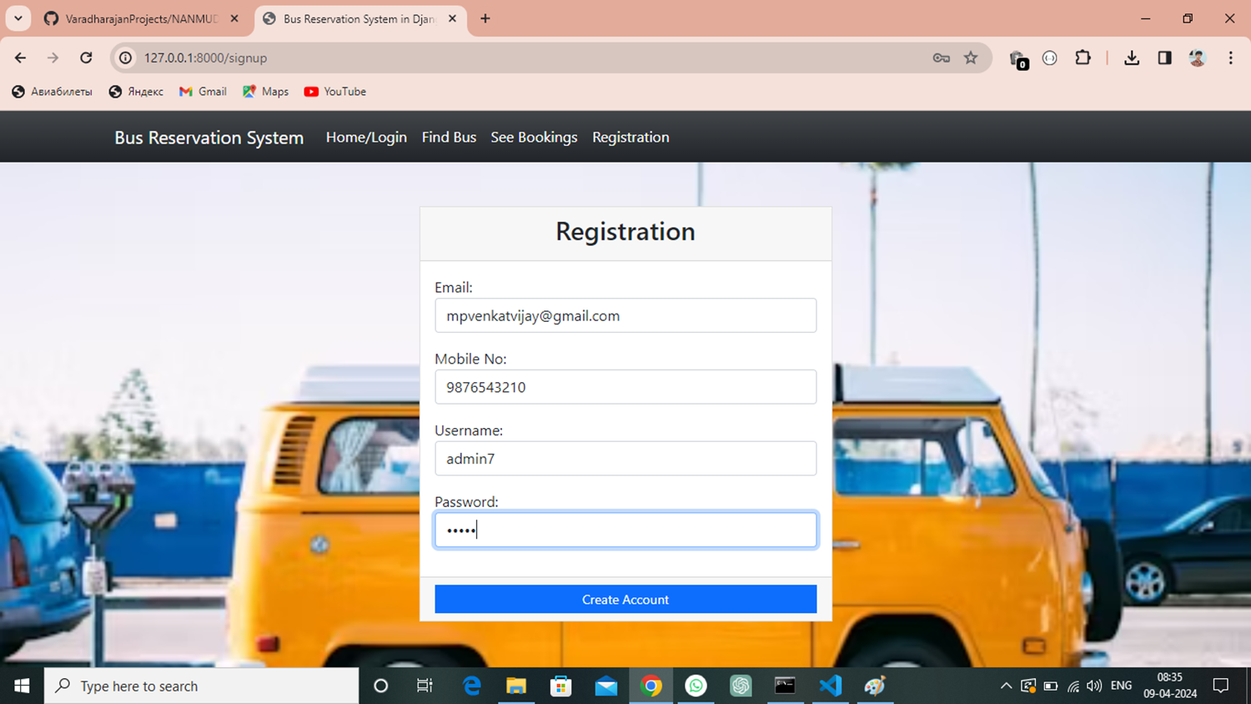
Blog-Page

Slide 16
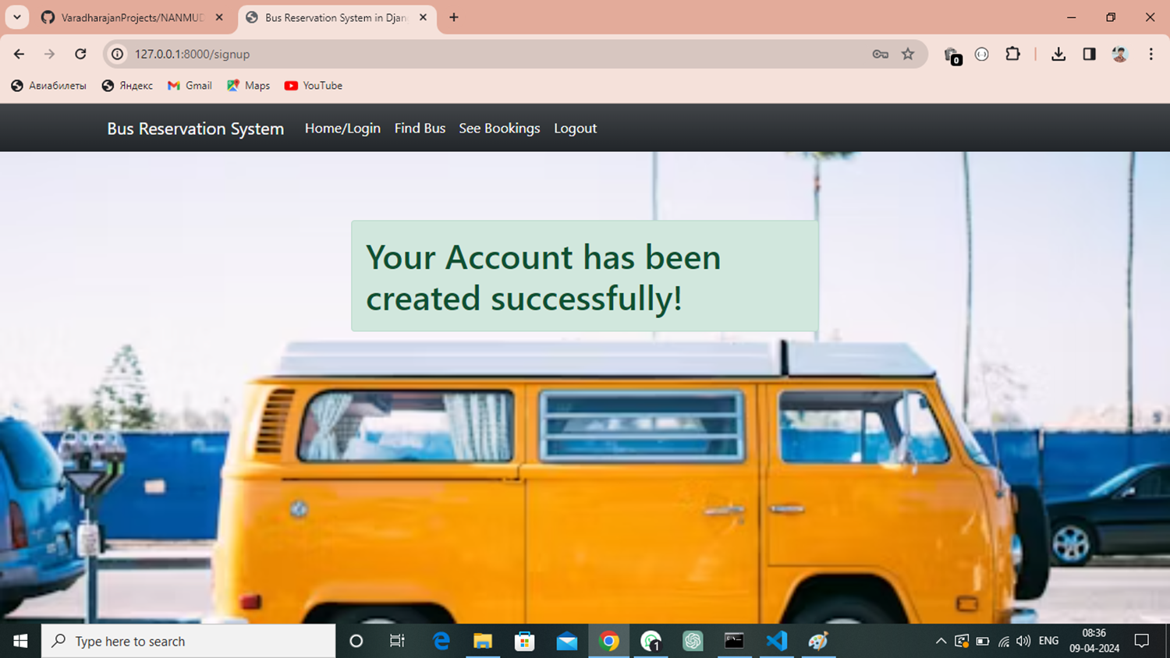
Future Enhancements:

Slide 17
Conclusion
In conclusion, the implementation of a bus booking reservation system significantly enhances the efficiency and convenience of managing bus travel for both passengers and service providers. By leveraging modern technology, such a system streamlines the entire booking process, reduces errors, and improves customer satisfaction. With features like real-time seat availability, online payments, and user-friendly interfaces, passengers can effortlessly plan their journeys while operators can optimize their resources and provide better services. As the travel industry continues to evolve, investing in innovative solutions like a bus booking reservation system is essential for staying competitive and meeting the growing expectations of today's travelers.
Source :

Slide 18
Thank You!
Notes:
Thank You !!

